Slide 1


Indonesian Scholar Scientific Summit (I3S) | 2021
Rebuilding Post-Pandemic Societies
Forecasting Covid-19
Vaccines
Type of Vaccines

Slide 2
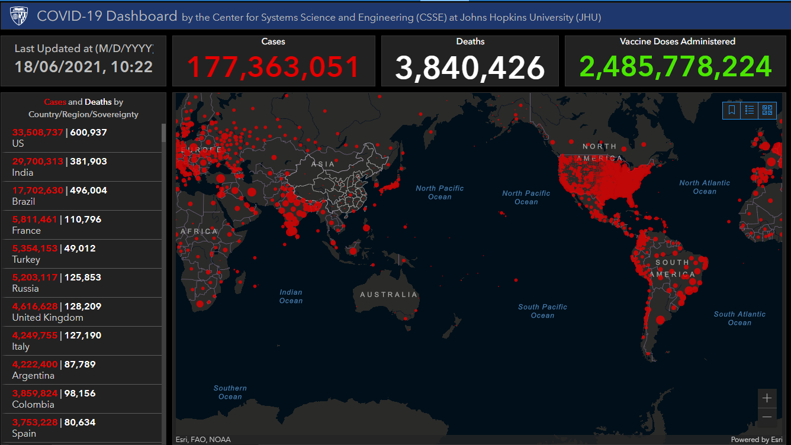
Forecasting Covid19 Vaccines | I3S 2021
Depend on Type of Vaccine
Notes:
As we all know, It has been more than a year that the coronavirus problem has emerged.//
As of Today, 28 May 2021, we can see in the picture the total global cases reported are more than ___ cases.
And the region that have red color are where the case is occur and as we can see almost all region were cover with red color. //

Slide 3
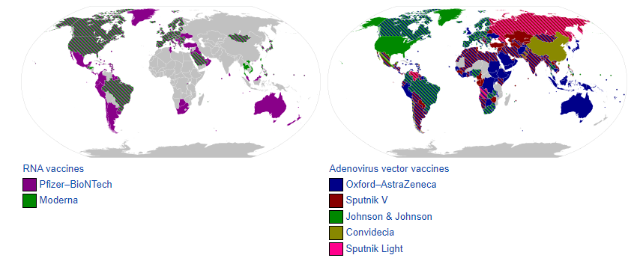
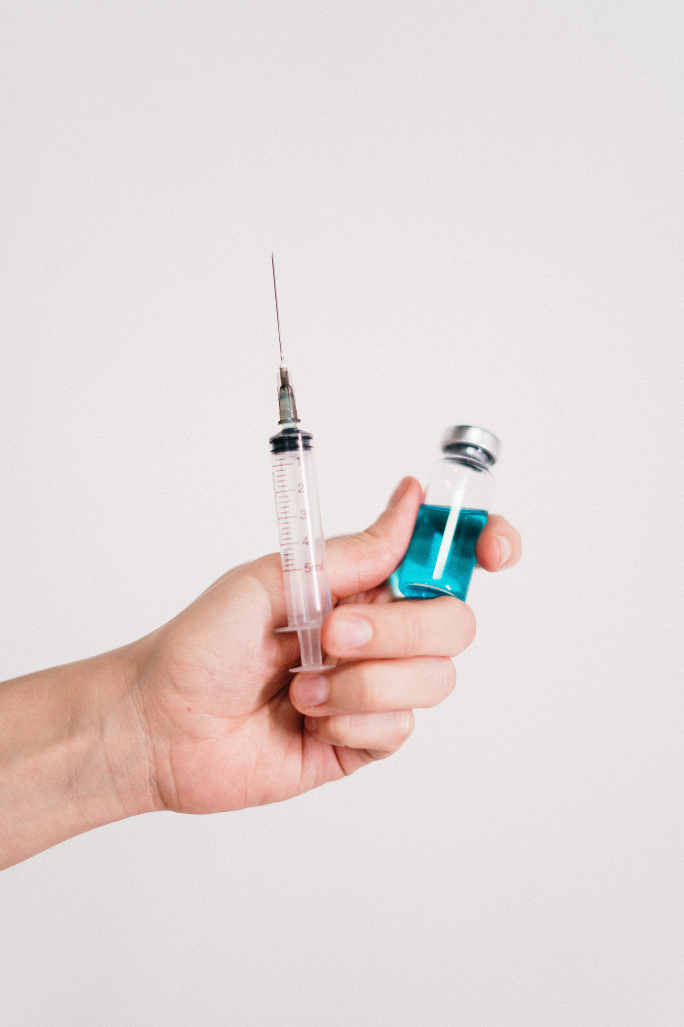
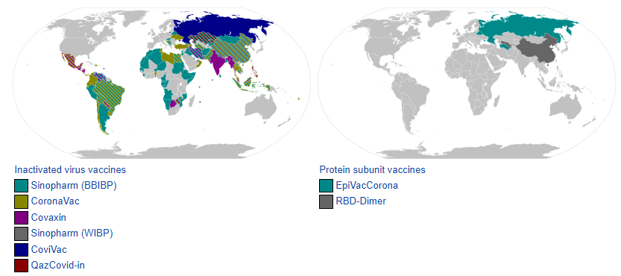
Forecasting Covid19 Vaccines | I3S 2021
Depend on Type of Vaccine
Vaccines for Covid19
13 different vaccines
(across 4 platforms)
have been administered
Notes:
All researchers are trying to develop a vaccine to reduce the number of covid-19 cases and finally the first mass vaccination programme started in early December, 2020 and 13 different vaccines (across 4 platforms) have been administered. the name of the vaccine and distribution area can be seen in the figure.

Slide 4

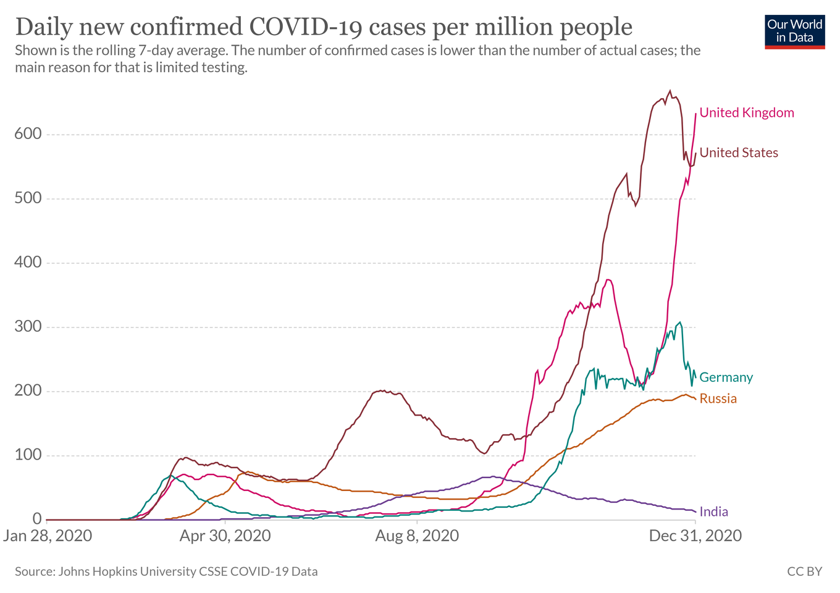
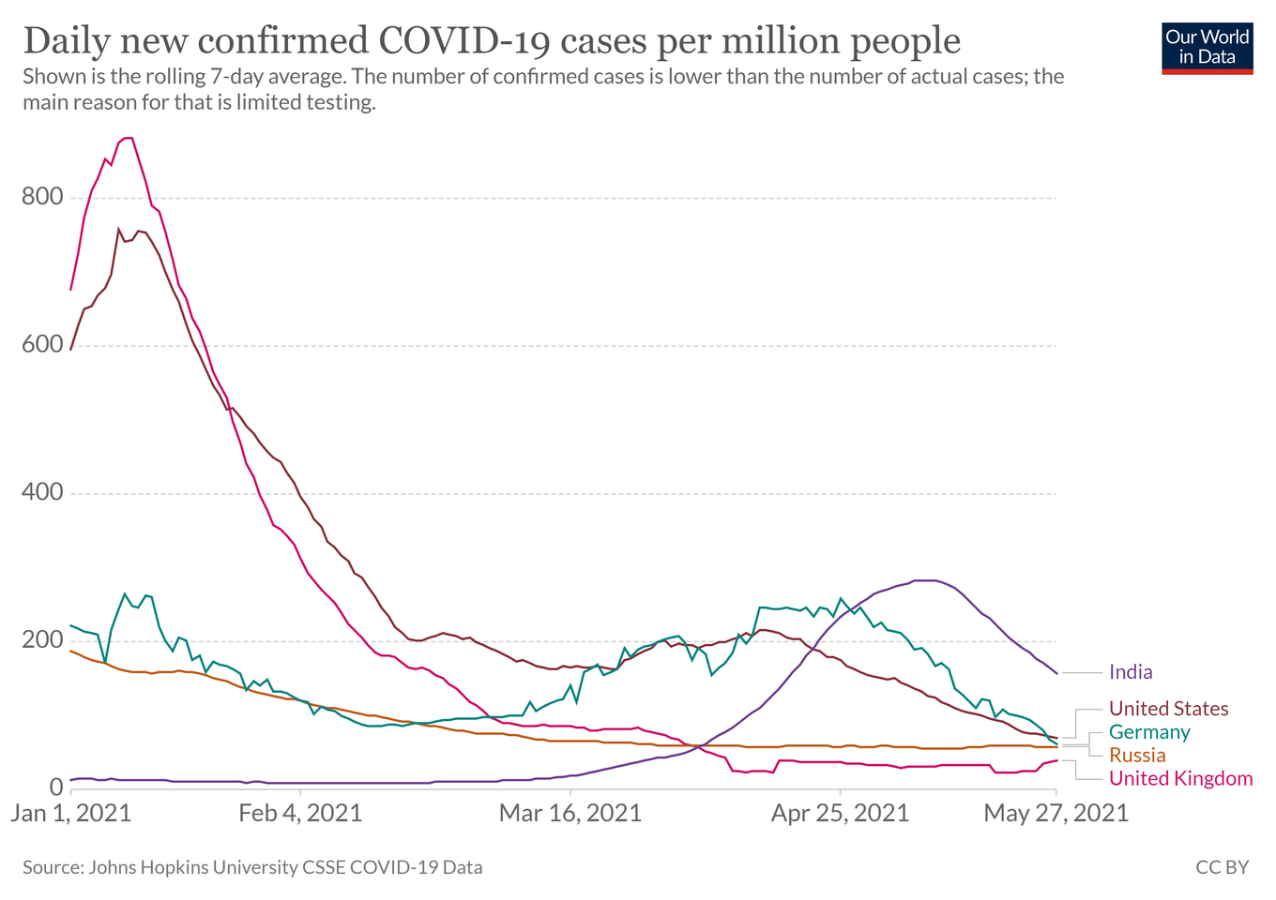
Forecasting Covid19 Vaccines | I3S 2021
Depend on Type of Vaccine
Covid19 Cases
Before Vaccine
9 April 2021
After Vaccine
Notes:
All researchers are trying to develop a vaccine to reduce the number of covid-19 cases and finally the first mass vaccination programme started in early December, 2020 and 13 different vaccines (across 4 platforms) have been administered. the name of the vaccine and distribution area can be seen in the figure.

Slide 5
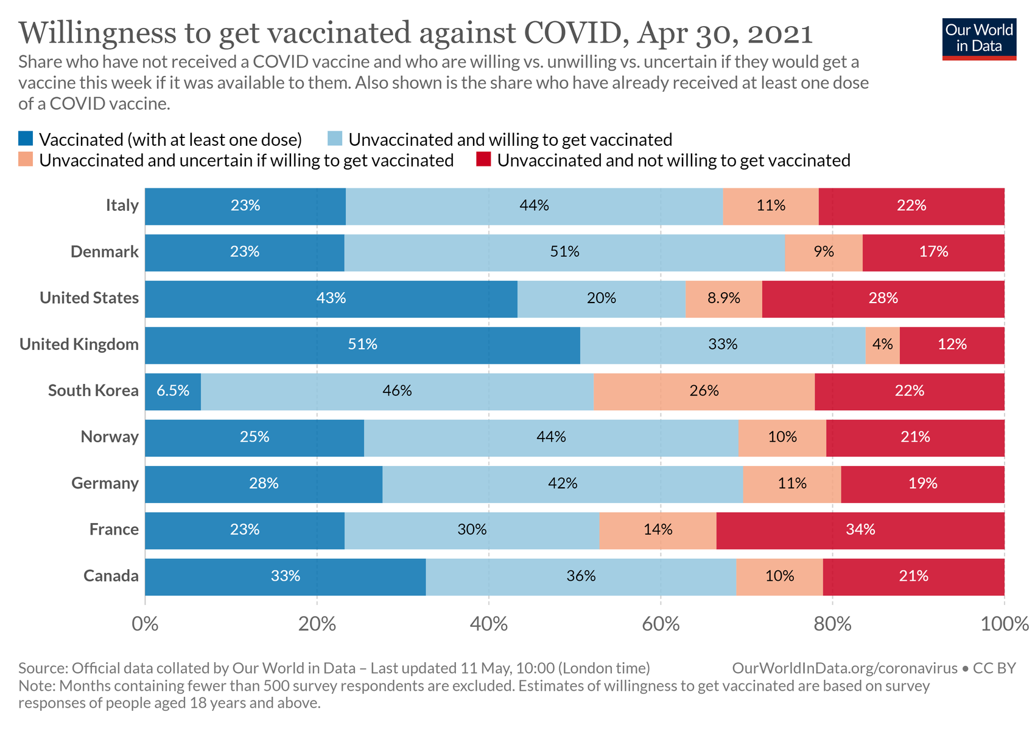
Willingness
Progress Vaccinations on Country who have been got Dozen of Vaccine
Notes:
All researchers are trying to develop a vaccine to reduce the number of covid-19 cases and finally the first mass vaccination programme started in early December, 2020 and 13 different vaccines (across 4 platforms) have been administered. the name of the vaccine and distribution area can be seen in the figure.

Slide 6
Forecasting Covid19 Vaccines | I3S 2021
Depend on Type of Vaccine
Vaccine’s Prediction
Take more than a year to produce enough vaccines
to inoculate the World’s 50 million medical staff, and
that could be September 2023 before we have
enough doses for the whole World.
— Anthony McDonnell, Robert Van Exan, Steve Lloyd, et.al
Notes:
All researchers are trying to develop a vaccine to reduce the number of covid-19 cases and finally the first mass vaccination programme started in early December, 2020 and 13 different vaccines (across 4 platforms) have been administered. the name of the vaccine and distribution area can be seen in the figure.

Slide 7
Forecasting Covid19 Vaccines | I3S 2021
Depend on Type of Vaccine
Related Study
De Figueiredo
United Kingdom is the government chose to distribute its vaccine variants, namely AstraZeneca and Pfizer-BioNTech [2]. The government has such confidence that the vaccine's findings are compatible with the physiology of its citizens
Trtica-Majnaric et al.
Describes future forecasting on influenza vaccines using two deep learning comparison methods, namely Linear Regression and Neural Network [3]. forecasting using the NN model is better than the LR model, with an average hit rate of 72%.
Notes:
All researchers are trying to develop a vaccine to reduce the number of covid-19 cases and finally the first mass vaccination programme started in early December, 2020 and 13 different vaccines (across 4 platforms) have been administered. the name of the vaccine and distribution area can be seen in the figure.

Slide 8

Forecasting Covid19 Vaccines | I3S 2021
Depend on Type of Vaccine
Main Contributions
Trends in the distribution of Covid19 Vaccines
Comparision of the original and predicted values generated in the Covid19 vaccine trend
Future forecasting results from Covid19 vaccines data
Evaluate the accuracy and precision of the tested data

Slide 9
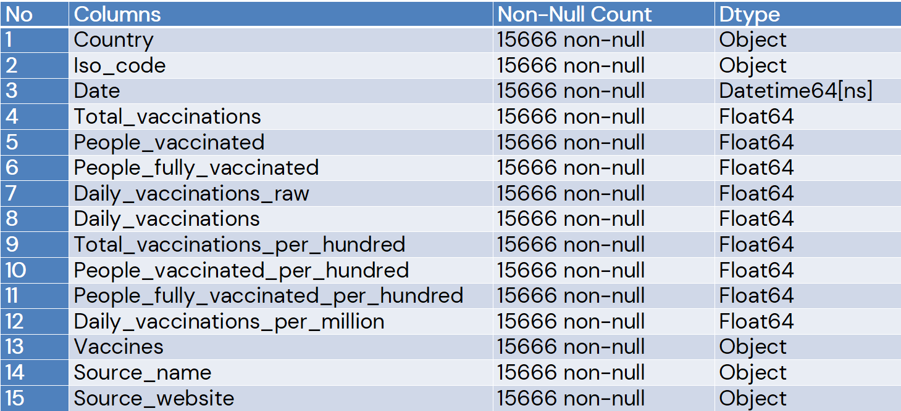
Dataset
Forecasting Covid19 Vaccines | I3S 2021
Depend on Type of Vaccine
Dataset COVID-19 World Vaccination Progress
https://www.kaggle.com/gpreda/covid-world-vaccination-progress
Dataset COVID-19
Dataset COVID-19 World Vaccination Progress [4]
Notes:
All researchers are trying to develop a vaccine to reduce the number of covid-19 cases and finally the first mass vaccination programme started in early December, 2020 and 13 different vaccines (across 4 platforms) have been administered. the name of the vaccine and distribution area can be seen in the figure.

Slide 10

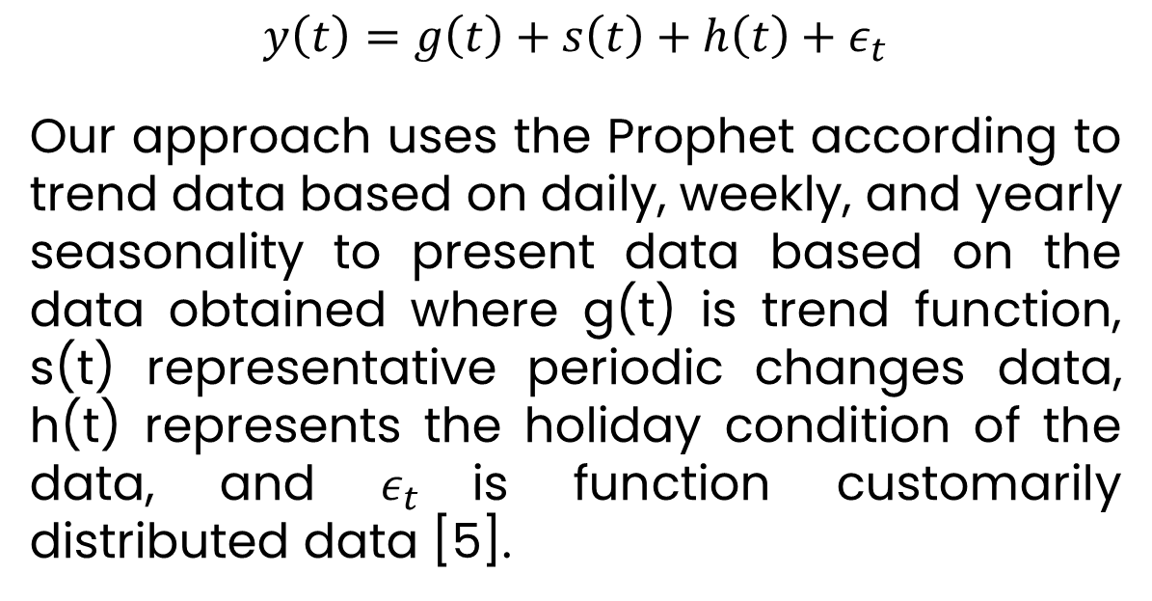
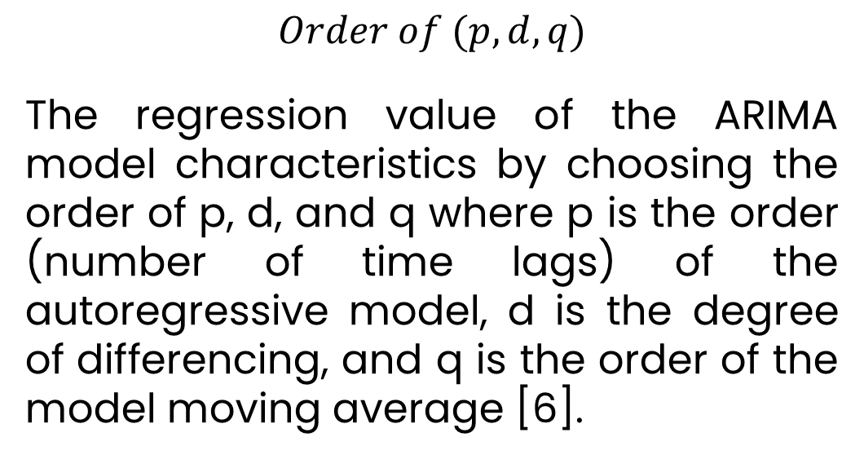
Forecasting Covid19 Vaccines | I3S 2021
Depend on Type of Vaccine
Methods
Facebook Prophet
ARIMA
$$y\left(t\right)=g\left(t\right)+s\left(t\right)+h\left(t\right)+ε_{t}$$
Our approach uses the Prophet according to trend data based on daily, weekly, and yearly seasonality to present data based on the data obtained where g(t) is trend function, s(t) representative periodic changes data, h(t) represents the holiday condition of the data, and $ε_{t}$is function customarily distributed data [5].
$$Order of (p, d, q)$$
The regression value of the ARIMA model characteristics by choosing the order of p, d, and q where p is the order (number of time lags) of the autoregressive model, d is the degree of differencing, and q is the order of the model moving average [6].
Notes:
All researchers are trying to develop a vaccine to reduce the number of covid-19 cases and finally the first mass vaccination programme started in early December, 2020 and 13 different vaccines (across 4 platforms) have been administered. the name of the vaccine and distribution area can be seen in the figure.

Slide 11
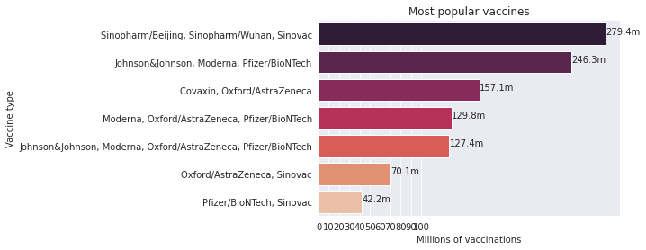
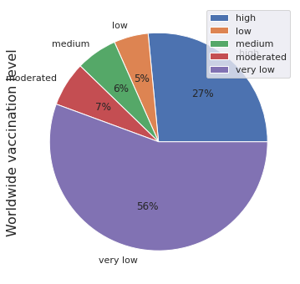
Dataset
Forecasting Covid19 Vaccines | I3S 2021
Depend on Type of Vaccine
Dataset COVID-19 World Vaccination Progress
https://www.kaggle.com/gpreda/covid-world-vaccination-progress
Exploratory Data Analysis
Most Popular Vaccines
Notes:
All researchers are trying to develop a vaccine to reduce the number of covid-19 cases and finally the first mass vaccination programme started in early December, 2020 and 13 different vaccines (across 4 platforms) have been administered. the name of the vaccine and distribution area can be seen in the figure.

Slide 12
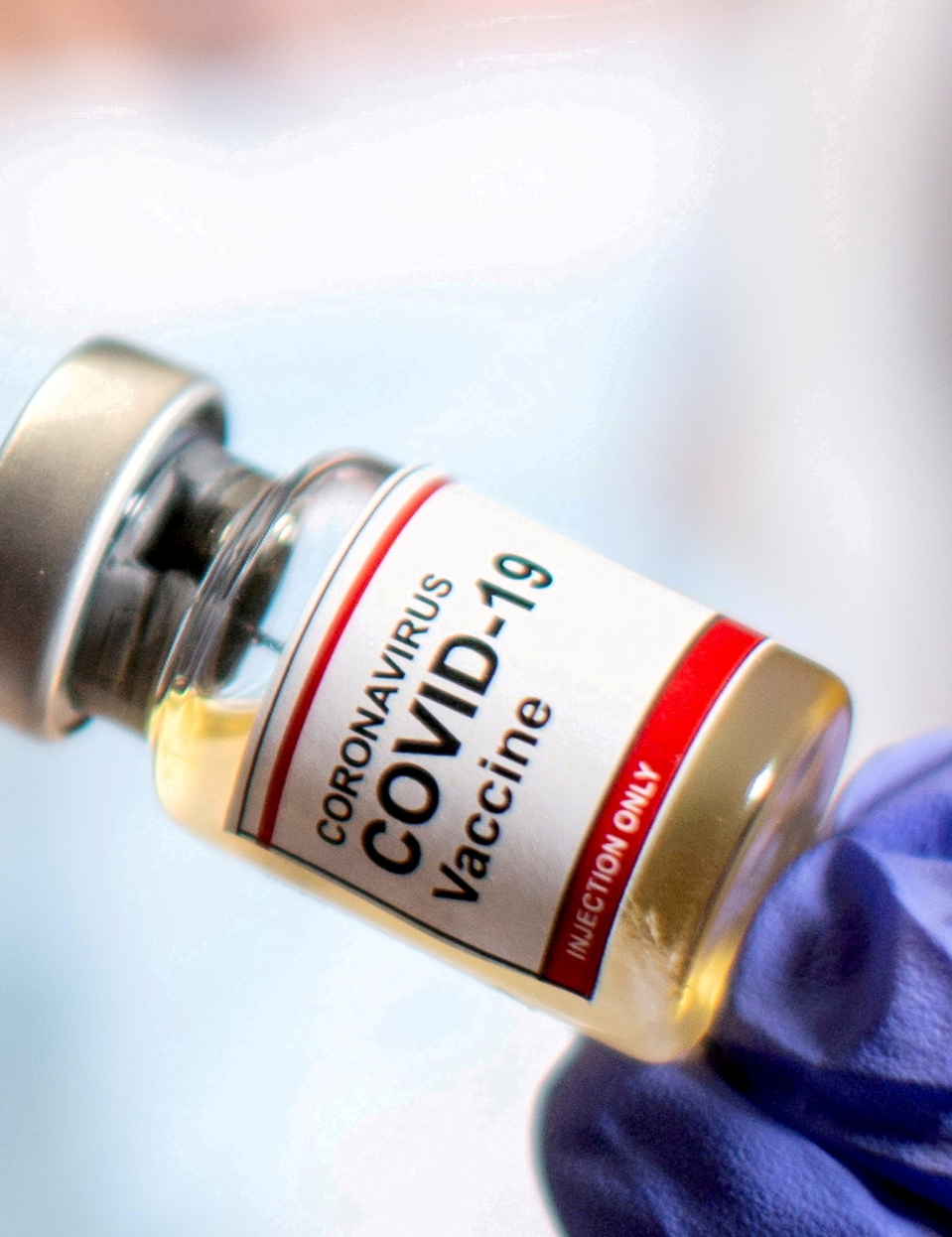
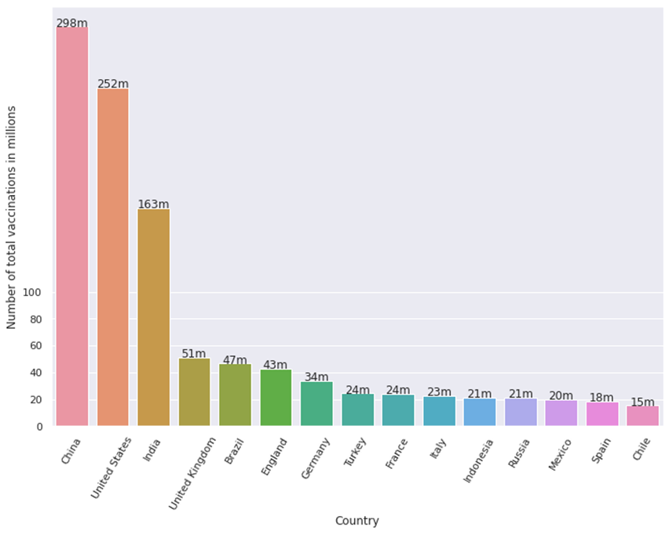
Dataset
Forecasting Covid19 Vaccines | I3S 2021
Depend on Type of Vaccine
Dataset COVID-19 World Vaccination Progress
https://www.kaggle.com/gpreda/covid-world-vaccination-progress
Exploratory Data Analysis
Total Vaccinations by Country
Notes:
All researchers are trying to develop a vaccine to reduce the number of covid-19 cases and finally the first mass vaccination programme started in early December, 2020 and 13 different vaccines (across 4 platforms) have been administered. the name of the vaccine and distribution area can be seen in the figure.

Slide 13

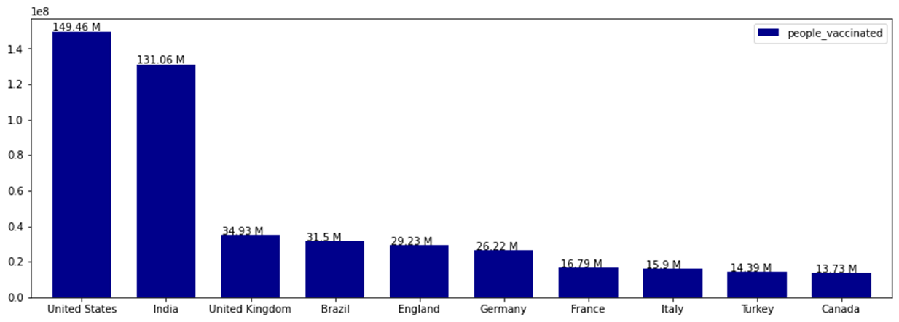

Dataset
Forecasting Covid19 Vaccines | I3S 2021
Depend on Type of Vaccine
Dataset COVID-19 World Vaccination Progress
https://www.kaggle.com/gpreda/covid-world-vaccination-progress
Exploratory Data Analysis
People Vaccinated by Country
Notes:
All researchers are trying to develop a vaccine to reduce the number of covid-19 cases and finally the first mass vaccination programme started in early December, 2020 and 13 different vaccines (across 4 platforms) have been administered. the name of the vaccine and distribution area can be seen in the figure.

Slide 14
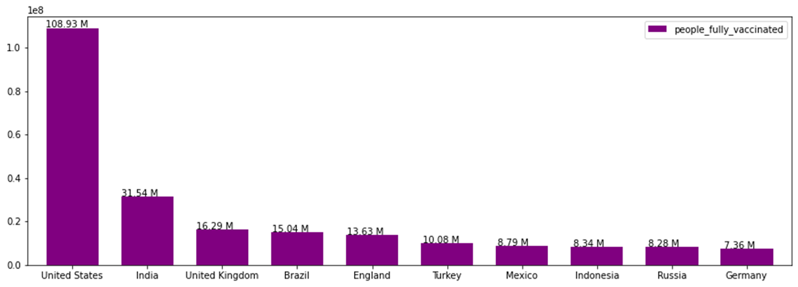
Dataset
Forecasting Covid19 Vaccines | I3S 2021
Depend on Type of Vaccine
Dataset COVID-19 World Vaccination Progress
https://www.kaggle.com/gpreda/covid-world-vaccination-progress
Exploratory Data Analysis
People Fully Vaccinated by Country
Notes:
All researchers are trying to develop a vaccine to reduce the number of covid-19 cases and finally the first mass vaccination programme started in early December, 2020 and 13 different vaccines (across 4 platforms) have been administered. the name of the vaccine and distribution area can be seen in the figure.

Slide 15
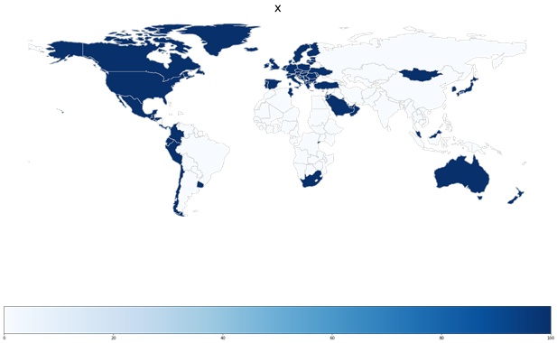
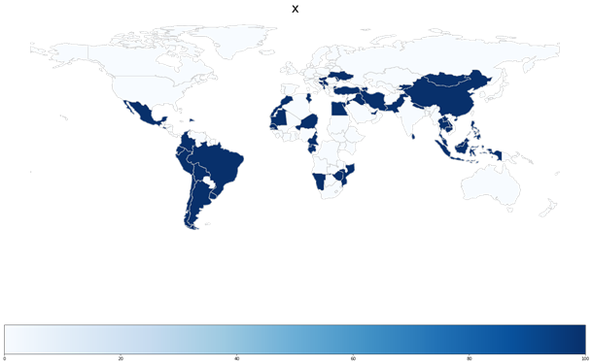
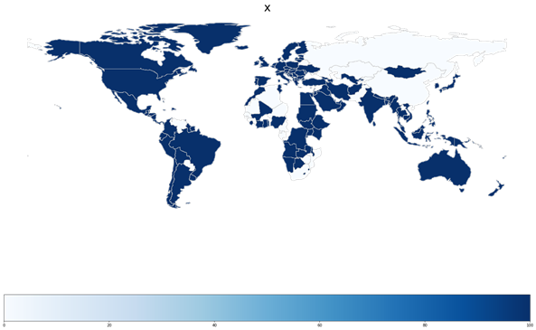
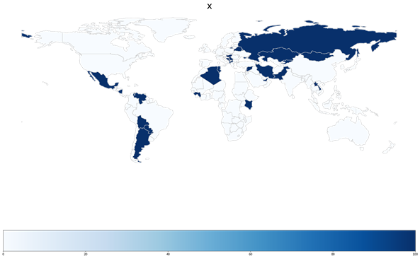
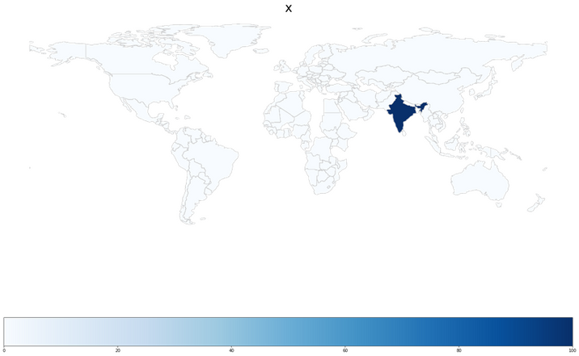
Dataset
Forecasting Covid19 Vaccines | I3S 2021
Depend on Type of Vaccine
Dataset COVID-19 World Vaccination Progress
https://www.kaggle.com/gpreda/covid-world-vaccination-progress
Exploratory Data Analysis
American Vaccines
Russian Vaccines
Europian Vaccines
Chinese
Vaccines
Indian Vaccines
Notes:
All researchers are trying to develop a vaccine to reduce the number of covid-19 cases and finally the first mass vaccination programme started in early December, 2020 and 13 different vaccines (across 4 platforms) have been administered. the name of the vaccine and distribution area can be seen in the figure.

Slide 16
Forecasting Covid19 Vaccines | I3S 2021
Depend on Type of Vaccine
Experiment Step Works
Input Data
Data Preprocessing
Fitting Model
Output Data
Group by Type Vaccines
Stationary Check
Prophet and ARIMA Model
Forecast vs. Actual
Select by People Vaccinated /hundred
Differencing
Daily Seasonality
Future Prediction
Correlation Check
Dataset COVID-19 World Vaccination Progress
https://www.kaggle.com/gpreda/covid-world-vaccination-progress

Slide 17
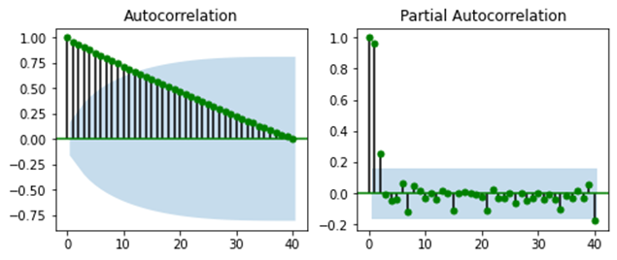
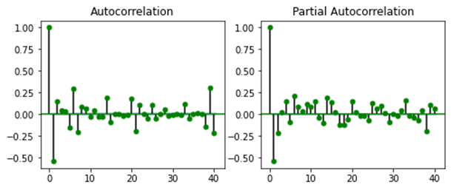
Forecasting Covid19 Vaccines | I3S 2021
Depend on Type of Vaccine
Data Preprocessing
Before Differencing
After Differencing

Slide 18

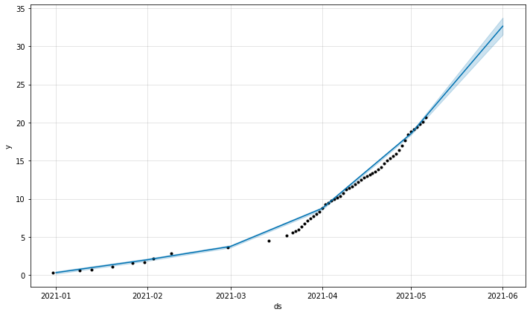
Prophet Deep Learning
Implementation
Forecast and Actual ARIMA
Future Forecast until June 1, 2021
Daily Seasonality
Sinopharm and Sinovac
Total Vaccinations per Hundred

Slide 19

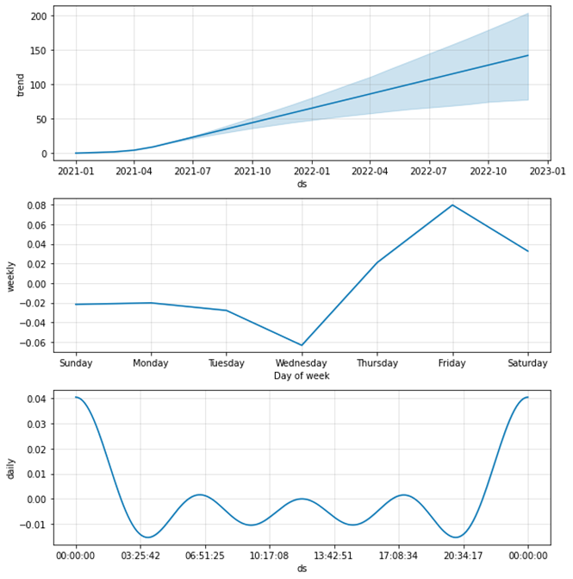
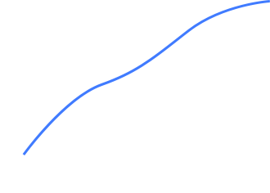
Prophet Deep Learning
Implementation
Trend
Weekly
Seasonality Forecast
Daily

Slide 20
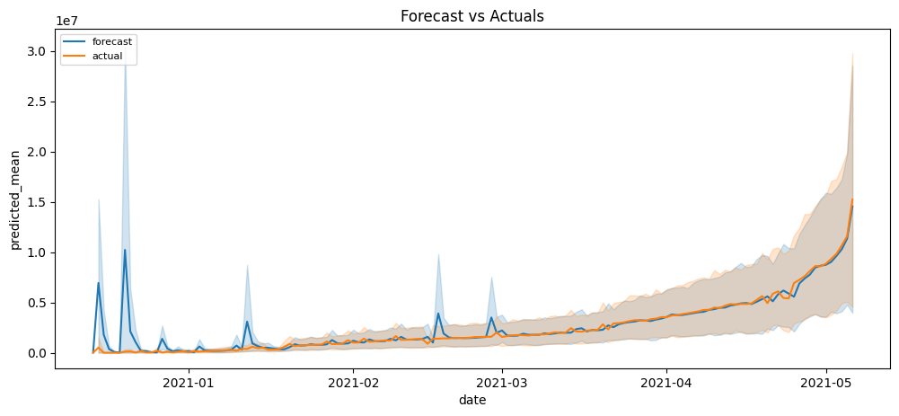
ARIMA Deep Learning
Implementation
Forecast and Actual ARIMA
Future Forecast until June 1, 2021
Train : Test = 80:20
Sinopharm and Sinovac
Total Vaccinations per Hundred

Slide 21
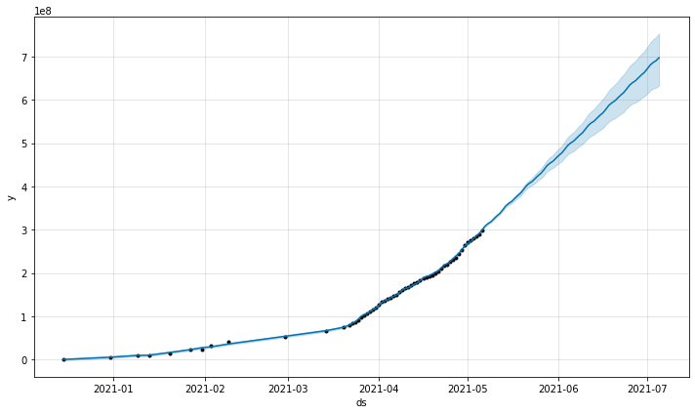
Forecasting Covid19 Vaccines | I3S 2021
Depend on Type of Vaccine
Future Forecasting
ds | yhat | yhat_lower | yhat_upper
2021-07-01 | 6.712125e+08 | 6.141475e+08 | 7.220045e+08
2021-07-02 | 6.801729e+08 | 6.216502e+08 | 7.318220e+08
2021-07-03 | 6.860007e+08 | 6.258757e+08 | 7.395016e+08
2021-07-04 | 6.903211e+08 | 6.280171e+08 | 7.446853e+08
2021-07-05 | 6.970889e+08 | 6.332544e+08 | 7.535284e+08
Facebook Prophet

Slide 22
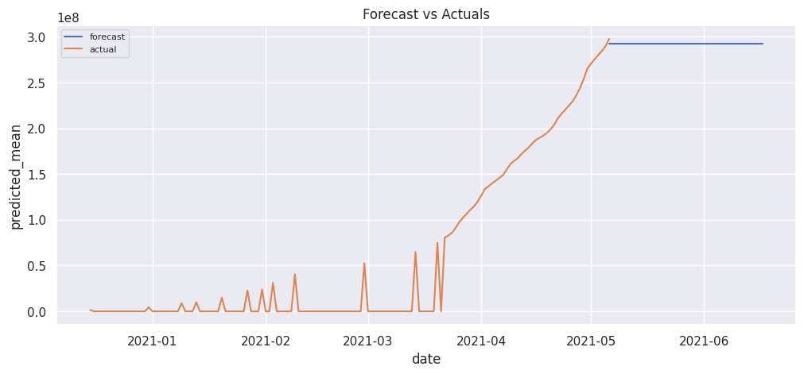
Forecasting Covid19 Vaccines | I3S 2021
Depend on Type of Vaccine
Future Forecasting
ds | pred
2021-06-13 | 2.923380e+08
2021-06-14 | 2.923380e+08
2021-06-15 | 2.923380e+08
2021-06-16 | 2.923380e+08
2021-06-17 | 2.923380e+08
ARIMA

Slide 23
Evaluation Metrics
Model | Evaluation Metrics
 | MSE | MAPE | R2 | MAE | MedAE | RMSE | MEAN
ARIMA | 0.6139603 | 0.0473144 | 0.97560 | 0.58201 | 0.549417 | 0.61396 | 13.153095
Prophet | 0.0309044 | 0.0103888 | 0.99876 | 0.15473 | 0.154735 | 0.17579 | 13.64026

Slide 24
Conclutions
Development Future Prediction
Prophet is Best Forecasting Model
Considering Another Field
Results for COVID-19 vaccines development to useful to encourage the government to make decision to provide vaccines.
Comparison with another model, Prophet getting higher result based evaluation metrics with minimum error.
For making a precision decision, another field such as social-economic and important cases will be influence the predictions

Slide 25
References
[1] C. for S. S. E. (CSEE), “COVID-19 Map,” 2021. https://coronavirus.jhu.edu/map.html (accessed May 24, 2021).
[2] A. de Figueiredo, “Forecasting sub-national trends in COVID-19 vaccine uptake in the UK,” medRxiv, pp. 1–17, 2020.
[3] L. Trtica-Majnaric, M. Zekic-Susac, N. Sarlija, and B. Vitale, “Prediction of influenza vaccination outcome by neural networks and logistic regression,” Journal of Biomedical Informatics, vol. 43, no. 5, pp. 774–781, 2010, DOI: 10.1016/j.jbi.2010.04.011.
[4] G.Preda, “COVID-19 World Vaccination Progress,” 2021. https://www.kaggle.com/gpreda/COVID-world-vaccination-progress (accessed May 19, 2021).
[5] E. Žunić, K. Korjenić, K. Hodžić, and D. Đonko, “Application of Facebook’S Prophet Algorithm for Successful Sales Forecasting Based On Real-World Data,” arXiv, vol. 12, no. 2, pp. 23–36, 2020, DOI: 10.5121/ijcsit.2020.12203.
[6] S. L. Ho and M. Xie, “The Use of ARIMA Models for Reliability Forecasting and Analysis,” in 23rd International Conference on Computers and Industrial Engineering, 1998, vol. 35, no. 98, pp. 213–216.

